Slide 1
E Early Britons
Made by Awali and Kwame

Slide 2
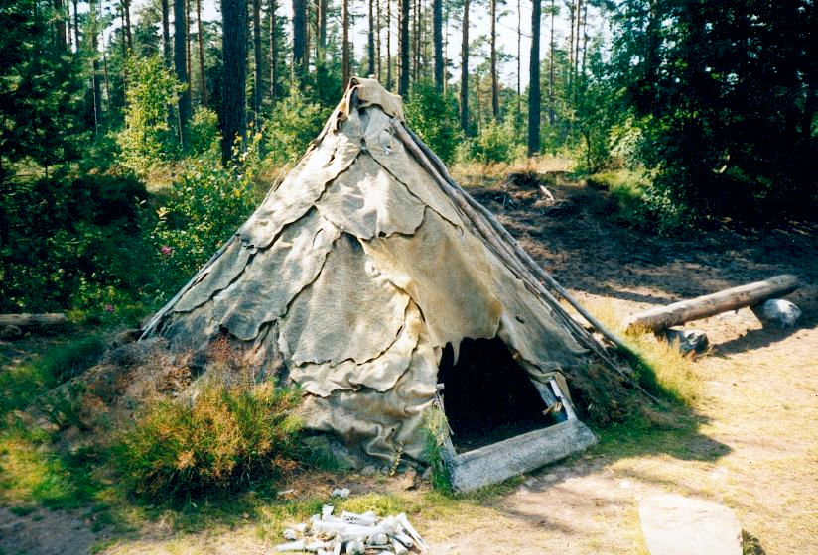
Shelter
Early shelters were adored by paintings.
Each house shares the same basic design.
A large square room and a central fireplace.
A bed on ether side and shelved dresser on the wall opposite the dootheres many more to come.

Slide 3
Roundhouses
What materials were used?
Sticks, wattle and duab were used to build the walls.
Straw and reeds were used to insulate the houses.
What would you find inside a roundhouse?
A loom for weaving clothes
A fire in the middle for heat ,light and cooking
A dome shaped oven was used to bake bread
A quern stone for grinding corn
Baskets to store food and there belongings.

Slide 4
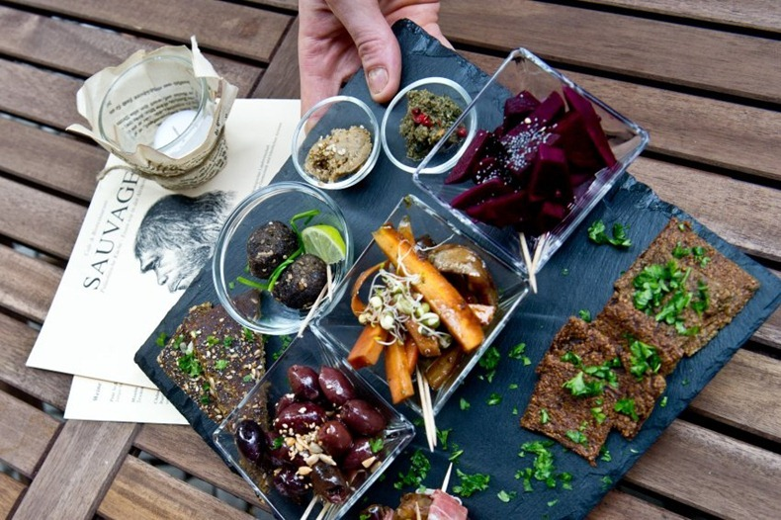
Food They eat brains and bums they eat cell fish or baked fish they eat reptiles eat fruit and vegetables They ate insects

Slide 5
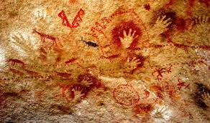
Stone age art
Human pictures were more decorated and had more detail.
The most common paintings are animals
Art was either portable or stationery
Portable art included statues or decorated objects. These things were carved from stoe, bone or antlers and were sometimes modelled with clay.
Stationary art included cave paintings. They used minerals and charcoal mixed with water, blood and animal fat.

Slide 6
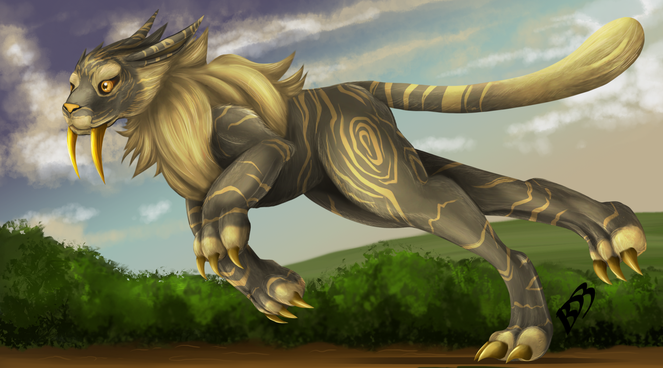
Animals
The sabre tooth tigers prey is a deer a bison and a
Mamoth.
The animals habbitat is forests and grasslands.
It weighs 1661bs.

Slide 7
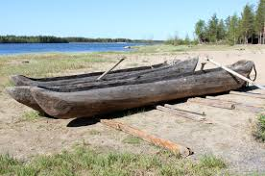
TRANS PORT
Boats were important ways to travel.
Boats would also have been able to carry much more cargo than pack animals and most early wheeled vehicles
Sea crossings would have been dangerous but were important trade routes
Travelling on rivers would have been much swifter, in most cases, than travelling by land before modern roads were built.
Some transport models were the early shafts, boats and kayaks.

