Slide 1
Early Britons
By Yousaf and Shabbir

Slide 2
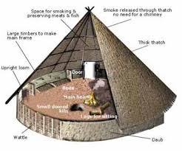
Early britons shelter
During the Neolithic stone age people settled into communities and built roundhouses to live in.
Inside a roundhouse you might have found:
A loom for weaving cloth.
hearth or fire in the middle that would be lit all the time for: heat, light, cooking and smoking food.
A dome shaped oven for baking bread.
A quern stone for grinding corn.
Beds with woollen blankets.
Baskets for storing food or belongings.

Slide 3
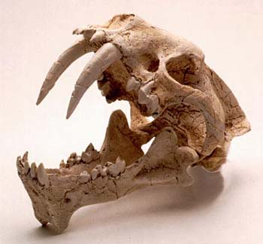
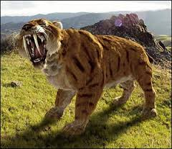
Stone age animals
All about sabre tooth tiger.
These teeth are used to kill animals in one bite.
7 inches teeth can kill you in one bite.
They have 2 very sharp teeth at the front.
The sabre tooth tiger skin keeps the stone age people warm in the winter.

Slide 4
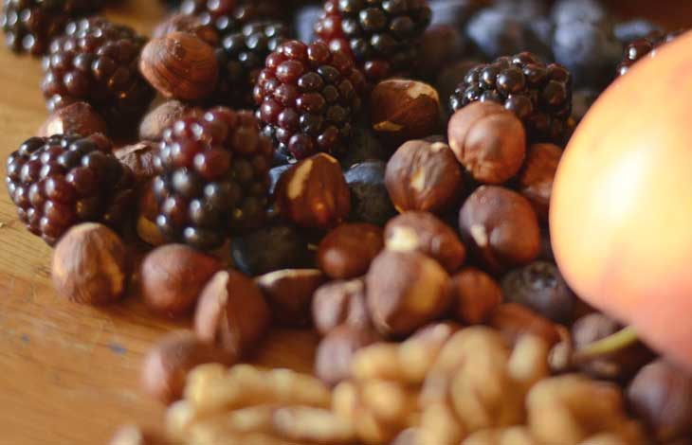
stone age food
They use spears to catch their food

