Slide 1
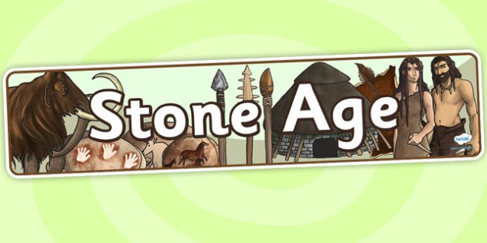
By Ulysses and Alexandra

Slide 2
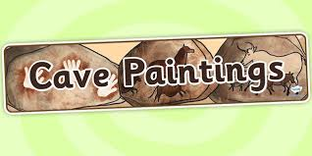
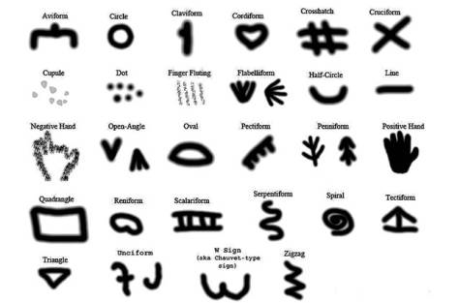
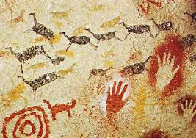
Stone age people draw on walls , caves, ceilings and rock.
Stone age people communicate with symbols
WOW FACT !!!
The oldest stone age paintings were the red dot and the hand print
Stone age people used blood to make the colour red

Slide 3
Stone age tools
These rocks was in the palaeolithic time
DID YOU KNOW ?
Stone age people use rocks to make their spears sharper .

Slide 4
stone age hunting
Stone age people hunt with spears
Stone age people hunt mammoth fur to make clothes .

Slide 5
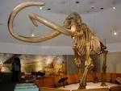
Stone age animals

