Slide 1
Stewards of Gods Earth
By Molly Keyes Y5

Slide 2
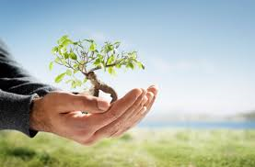
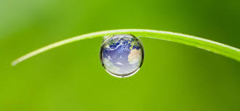
As stewards of the earth we need to look after gods planet.

Slide 3
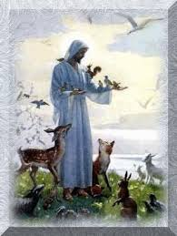
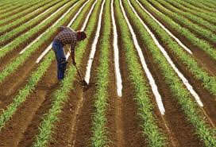
This includes planting crops and looking after our animals.

Slide 4
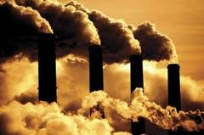
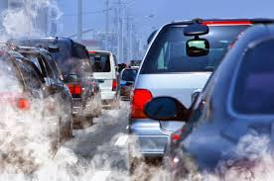
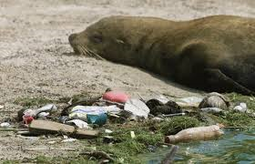
Also this includes not polluting our air and animals habitats .

Slide 5
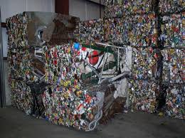
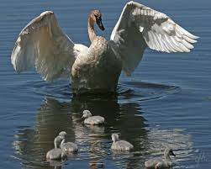
As stewards of gods earth we should recycle our rubbish, and protect our wildlife

Slide 6
So we need to be good stewards of gods earth so we can make our world clean and safe for everything in it.

Slide 7
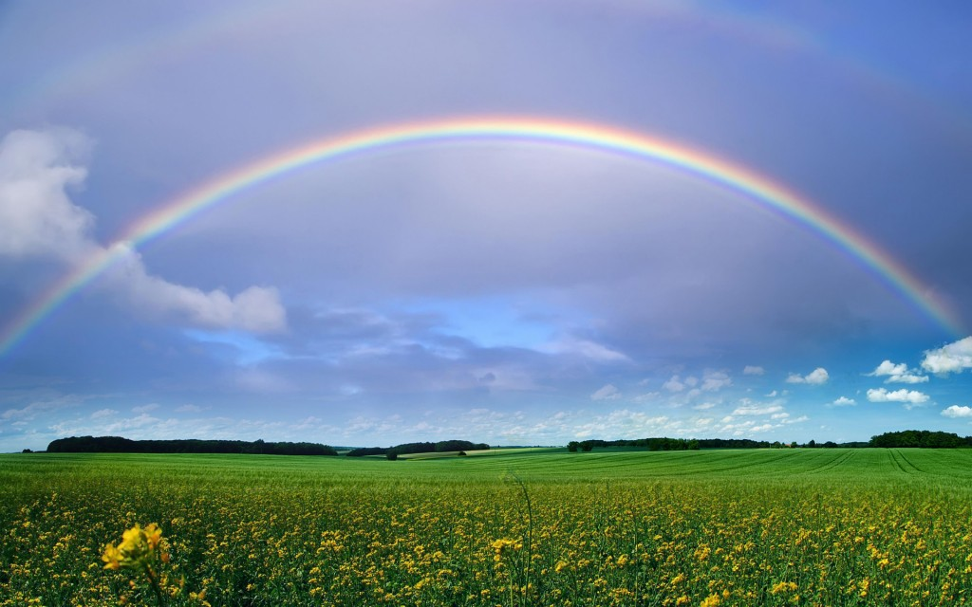
THE END

